Slide 1

Designing Boundary Classes
Based on Chapter 17 of Bennett, McRobb and Farmer:
Object Oriented Systems Analysis and Design Using UML, (2nd Edition), McGraw Hill, 2002.

Slide 2
In This Lecture You Will Learn:
What we mean by the presentation layer
How prototyping can be applied to user interface design
How to add boundary classes to the class model
How to model boundary classes in sequence diagrams
How design patterns can be applied to the user interface
How to model control using statecharts

Slide 3
Architecture of the
Presentation Layer
We aim to separate the classes that have the responsibility for the interface with the user, or with other systems, (boundary classes) from the business classes (entity classes) and the classes that handle the application logic (control classes)
This is the Three-Tier Architecture
Notes:
Note that there may be more than three layers, and that the logical layers can map to physical platforms in a number of ways.

Slide 4
Presentation Layer
Handles interface with users and other systems
Formats and presents data at the interface
Presentation can be for display as text or charts, printing on a printer, speech synthesis, or formatting in XML to transfer to another system
Provides a mechanism for data entry by the user, but the events are handled by control classes

Slide 5
Presentation Layer
Does not contain business classes—Clients, Campaigns, Adverts, Invoices, Staff etc.
Does not contain the business logic—rules like ‘A Campaign must have one and only one Campaign Manager’.
Doesn’t handle validation, beyond perhaps simple checks on formatting

Slide 6
Reasons for the
3-Tier Architecture
Logical design
The project team may be producing analysis and design models that are independent of the hardware and software environment in which they are to be implemented. For this reason, the entity classes, which provide the functionality of the application, will not include details of how they will be displayed.
Interface independence
Even if display methods could be added to classes in the application, it would not make sense to do so. Object instances of any one class will be used in many different use cases: sometimes their attributes will be displayed on screen, sometimes printed by a printer. There will not necessarily be any standard layout of the attributes that can be built into the class definition, so presentation of the attributes is usually handled by another class.
Reuse
One of the aims is to produce classes that can be reused in different applications. For this to be possible, the classes should not be tied to a particular implementation environment or to a particular way of displaying the attribute values of instances.

Slide 7
3-Tier Architecture
Different authors have used different terms
  Boundary , Entity, Control
  Model, View, Controller
  Human Interaction Component, Problem Domain Component, Task Management Component
  (not necessarily in the same order)

Slide 8
Developing Boundary Classes
Prototype the user interface
Design the classes
Model the interaction involved in the interface
Model the control of the interface using statechart diagrams (if necessary)

Slide 9
Prototyping the User Interface
A prototype is a model that looks, and partly behaves, like the finished product but lacks certain features
A prototype of the user interface is a horizontal prototype—it prototypes one layer of the system
A vertical prototype takes a sub-system and prototypes all the layers

Slide 10
Prototyping the User Interface
Distinction between
  prototypes developed in an iterative process that are elaborated to become part of the eventual system and
  prototypes developed to test out design ideas that are thrown away rather than being further enhanced
  (actually, they are not really thrown away, as they form part of the design)

Slide 11
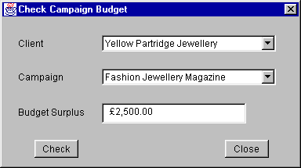
Check Campaign Budget
Use Case Prototype
In this prototype, Clients and Campaigns are selected in drop-down lists
There are other ways…

Slide 12
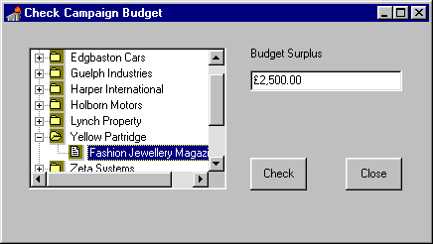
Check Campaign Budget
Use Case Prototype
Using a treeview control…

Slide 13
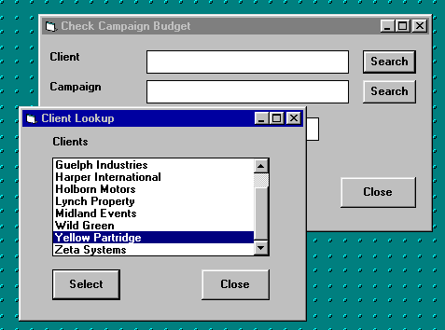
Check Campaign Budget
Use Case Prototype
Using a separate look-up window

Slide 14
Check campaign budget
Use Case Prototype
Choice of approach is part of the style guidelines discussed in Chapter 16
We are going to use the first approach, with drop-down lists
Although in Chapter 6, we looked at use cases for ‘Find campaign’, ‘Find client’ etc. as separate look-up windows, this approach is not what the Agate users want

Slide 15
Designing Classes
Start with the collaborations from the analysis model
Elaborate the collaborations to include necessary boundary, entity and control classes
Rosenberg and Scott (1999) treat control classes as placeholders—they represent some responsibility that has to be handled somewhere, but it may become an operation of another class

Slide 16
Collaboration for
Check campaign budget
Check Campaign Budget UI
Check Campaign Budget
Campaign
Advert
In order to find the right Campaign, we also need to use the Client class, even though it doesn’t participate in the real process of checking the budget
We also add control classes for the respons-ibilities of listing clients and campaigns

Slide 17
Collaboration for
Check campaign budget
List Clients
Client
Check Campaign Budget UI
Check Campaign Budget
Campaign
Advert
List Campaigns

Slide 18
Alternative Collaboration for
Check campaign budget
List Clients UI
List Clients
Client
Check Campaign Budget UI
Check Campaign Budget
Campaign
Advert
List Campaigns UI
List Campaigns

Slide 19
Class Diagram for CheckCampaignBudgetUI
Dialog
CheckCampaignBudgetUI
1
1
1
1
3
2
1
2
Label
Button
TextField
Choice

Slide 20
Single Class for CheckCampaignBudgetUI
Draw in your own lines to show which attribute is which element of the interface
CheckCampaignBudgetUI
- clientLabel : Label
- campaignLabel : Label
- budgetLabel : Label
- checkButton : Button
- closeButton : Button
- budgetTextField : TextField
- clientChoice : Choice
- campaignChoice : Choice

Slide 21
Package Dependencies
Classes can be shown with package names
AWT::Dialog
CheckCampaignBudgetUI
1
1
1
1
3
2
1
2
AWT::Label
AWT::Button
AWT::TextField
AWT::Choice

Slide 22
Package Dependencies
There is an «import» dependency between the two packages
  import java.awt.*; // In Java
  using System.Winforms; // in C#
AWT
«import»
Agate User
Interface

Slide 23
Sequence Diagrams
:Client
:Campaign
:Advert
Campaign
Manager
getName( )
listCampaigns( )
*getCampaignDetails( )
checkCampaignBudget( )
*getCost( )
getOverheads( )

Slide 24
Sequence Diagrams
The sequence diagram on the previous slide just shows the entity classes
We also have the collaboration diagram from an earlier slide showing the control and boundary classes
We now need to model the interaction more detail

Slide 25
First Part of Sequence Diagram
Campaign
Manager
:CheckCampaign
Budget
CheckCampaignBudget( )
ccbUI := Check
Campaign
BudgetUI( this )
:CheckCampaign
BudgetUI
:ListClients
lc := ListClients( )
listAllClients( ccbUI )
*addClientName( name )
enable( )

Slide 26
First Part of Sequence Diagram
The control class
  creates the instance of the boundary class
  creates the instance of the ListClients control class
  passes to :ListClients a reference to the boundary class
  :ListClients then sets the name of each client in turn into the boundary class by calling addClientname(name) repeatedly

Slide 27
Using Interfaces
We don’t mean user interfaces!
Many boundary classes will need to list clients to allow the user to select a client
The ListClients control class doesn’t need to know how the boundary class lists them
The boundary class needs to implement the ClientLister interface and provide an implementation of the operation addClientName(String)

Slide 28
Using Interfaces
Attributes can be private, only accessed through the public interface
«interface»
ClientLister
CheckCampaignBudgetUI
- clientLabel : Label
- campaignLabel : Label
+ addClientName(String)
- budgetLabel : Label
- checkButton : Button
«use»
- closeButton : Button
- budgetTextField : TextField
ListClients
- clientChoice : Choice
- campaignChoice : Choice
+ listAllClients(ClientLister)
+ enable( )

Slide 29
Java Implementation
import java.awt.*;
public class CheckCampaignBudgetUI extends
Frame implements ClientLister {
private Choice clientChoice;
...
public void addClientName(String name) {
clientChoice.addItem(name);
}
...
}

Slide 30
listAllClients( ) Operation
:ListClients
:ListClients
:Client
:Client
cl:ClientLister
:ClientLister
listAllClients( cl )
listAllClients( cl )
aClient := getNextClient( )
aClient := getNextClient( )
name := getName( )
name := getName( )
addClientName( name )
* [ while more clients ]
* [ while more clients ]

Slide 31
Second Part of Sequence Diagram
Campaign
Manager
:CheckCampaign
BudgetUI
:CheckCampaign
Budget
select client
clientSelected( )
aClient := getSelectedClient( )
:ListCampaigns
lc := ListCampaigns( )
listCampaigns( ccbUI, aClient )
*addCampaignName( name )
Notes:
Note that the :ListCampaigns object is using a CampaignLister interface to communicate with :CheckCampaignBudgetUI in the same way as :ListClients used the ClientLister interface.

Slide 32
Event-driven User Interface
Event in :clientChoice is passed through to the main boundary class
Campaign
Manager
clientChoice
:Choice
:CheckCampaign
BudgetUI
:CheckCampaign
Budget
select client
itemState
Changed( evt )
[evt.source = clientChoice] clientSelected( )

Slide 33
Revised Second Part of Sequence Diagram
Campaign
Manager
:CheckCampaign
BudgetUI
:CheckCampaign
Budget
select client
clientSelected( )
aClient := getSelectedClient( )
:ListCampaigns
lc := ListCampaigns( )
clearAllCampaignNames( )
listCampaigns( ccbUI, aClient )
*addCampaignName( name )
Notes:
clearAllCampaignNames() has been added to prevent more and more campaigns being added if a new client is selected.

Slide 34
Final Part of Sequence Diagram
Campaign
Manager
:CheckCampaign
BudgetUI
:CheckCampaign
Budget
:Campaign
:Advert
select campaign
campaignSelected( )
enableCheckButton( )
check budget
checkCampaignBudget( )
getCampaignSelected( )
checkCampaignBudget( )
*getCost( )
getOverheads( )
setBudget( )

Slide 35
Adding to the Class Diagram
From the sequence diagrams, we can see that the CheckCampaignBudgetUI class needs to implement both the ClientLister and the CampaignLister interfaces
There are also additional operations that have been introduced, some of which will apply to any class that implements these interfaces (and therefore belong to the interfaces), and some of which belong to the CheckCampaignBudgetUI class

Slide 36
ListCampaigns
«interface»
java::awt::event::ItemListener
+ listAllCampaigns(CampaignLister)
+ listCampaigns(CampaignLister, Client)
+ itemStateChanged(ItemEvent evt)
«use»
«interface»
CampaignLister
+ addCampaignName(String)
+ clearAllCampaignNames( )
+ removeCampaignName(String)
CheckCampaignBudgetUI
- clientLabel : Label
- campaignLabel : Label
«interface»
ClientLister
- budgetLabel : Label
- checkButton : Button
- closeButton : Button
+ addClientName(String)
+ clearAllClientNames( )
+ removeClientName(String)
- budgetTextField : TextField
- clientChoice : Choice
- campaignChoice : Choice
«use»
+ enable( )
+ enableCheckButton( )
+ getSelectedClient( )
+ getSelectedCampaign( )
+ setBudget(Currency)
ListClients
+ listAllClients(ClientLister)

Slide 37
Using Design Patterns
More and more, libraries of classes are built around design patterns
In Smalltalk, the Model–View–Controller architecture is widely used
In Java, an approach is used in which objects register an interest in events, then when an event occurs all the objects that have registered are notified of the event

Slide 38
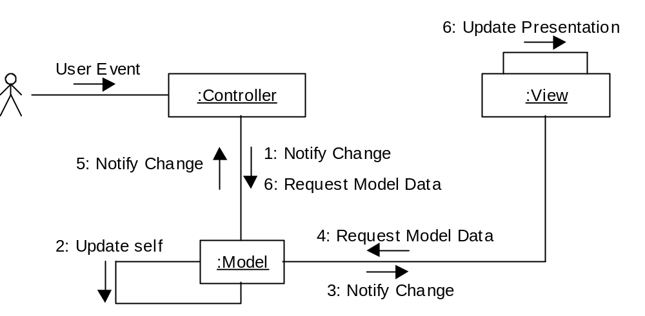
Model–View–Controller
/Controller
/View
/Model

Slide 39
Java Listener Approach
4 Update Self
User Event
:Component
:any:Class
1: itemStateChanged
(ItemEvent evt)
:ItemListener
2: Inspect Event
3: [Event of Interest]
Notify Class of Event

Slide 40
Java Approach
Various listeners for different kinds of user interface components
  MouseListener
  ItemListener
  ActionListener
All subinterfaces of EventListener

Slide 41
Java2 Enterprise
Edition (J2EE) Approach
J2EE is used for N-Tier distributed systems based on Enterprise Java Beans (EJB)
J2EE Core Patterns provides a pattern catalogue that uses the Model–View–Controller architecture

Slide 42
Modelling the User Interface in Statechart Diagrams
Different approaches to using statecharts
  Browne (1994), which was used in the 1st edition
  Horrocks (1999) used here
  Both based on the original work of Harel (1987)
  Recent work of Harel and Politi (1998)

Slide 43
Horrocks’ Approach
Five tasks:
  describe the high-level requirements and main user tasks
  describe the user interface behaviour
  define user interface rules
  draw the statechart (and successively refine it)
  prepare an event action table

Slide 44
High-level Requirements
The requirement here is that the users must be able to check whether the budget for an advertising campaign has been exceeded or not. This is calculated by summing the cost of all the adverts in a campaign, adding a percentage for overheads and subtracting the result from the planned budget. A negative value indicates that the budget has been overspent. This information is used by a campaign manager.

Slide 45
User Interface Behaviour
The client dropdown displays a list of clients. When a client is selected, their campaigns will be displayed in the campaign dropdown.
The campaign dropdown displays a list of campaigns belonging to the client selected in the client dropdown. When a campaign is selected the check button is enabled.
The budget textfield displays the result of the calculation to check the budget.
The check button causes the calculation of the budget balance to take place.
The close button closes the window and exits the use case.

Slide 46
Define User Interface Rules
User interface objects with constant behaviour
  The client dropdown has constant behaviour. Whenever a client is selected, a list of campaigns is loaded into the campaign dropdown
  The budget textfield is initially empty. It is cleared whenever a new client is selected or a new campaign is selected. It is not editable
  The close button may be pressed at any time to close the window

Slide 47
Define User Interface Rules
User interface objects with varying behaviour
  The campaign dropdown is initially disabled. No campaign can be selected until a client has been selected. Once it has been loaded with a list of campaigns it is enabled
  The check button is initially disabled. It is enabled when a campaign is selected. It is disabled whenever a new client is selected

Slide 48
Define User Interface Rules
Entry and exit events
  The window is entered from the main window when the Check Campaign Budget menu item is selected
  When the close button is clicked, an alert dialogue is displayed. This asks ‘Close window? Are you sure?’ and displays two buttons labelled ‘OK’ and ‘Cancel’. If ‘OK’ is clicked the window is exited; if ‘Cancel’ is clicked then it carries on in the state it was in before the close button was clicked

Slide 49
Draw the Statechart
We start with the top-level statechart for movement between the windows and dialogues
Main Window
checkCampaignBudget
MenuSelected( )
‘OK’
Check Budget
Window
closeButtonClicked( )
Alert Dialogue
‘Cancel’

Slide 50
Draw the Statechart
Client selection states are nested within the Check Budget Window state
No Client
Selected
clientSelected( )
Client Selected
clientSelected( )

Slide 51
Draw the Statechart
Campaign selection states are nested within the Client Selected state
No Campaign
Selected
campaignSelected( )
Campaign
Selected
campaignSelected( )

Slide 52
Draw the Statechart
Display of result states are nested within Campaign Selected state
Blank
checkButtonPressed( )
Display
Result
checkButtonPressed( )

Slide 53
Main Window
‘OK’
7 Alert Dialogue
‘Cancel’
checkCampaignBudget
MenuSelected( )
closeButtonClicked( )
Check Budget Window
H*
1 No Client
Selected
clientSelected( )
clientSelected( )
2 Client Selected
3 No Campaign
Selected
campaignSelected( )
campaignSelected( )
4 Campaign Selected
5 Blank
checkButtonPressed( )
6 Display
Result
checkButtonPressed( )

Slide 54
Draw the Statechart
Non-UML features:
  Horrocks numbers the states
  State variables can be shown in square brackets
Statechart can be simplified (as on next slide)
Rather than try to add all messages associated with transitions into the diagram, an Event–Action table can be used

Slide 55
Main Window
‘OK’
5 Alert Dialogue
‘Cancel’
checkCampaignBudget
MenuSelected( )
closeButtonClicked( )
Check Budget Window
H*
1 No Client
Selected
clientSelected( )
clientSelected( )
2 No Campaign
Selected
campaignSelected( )
campaignSelected( )
3 Blank
checkButtonPressed( )
4 Display
Result
checkButtonPressed( )

Slide 56
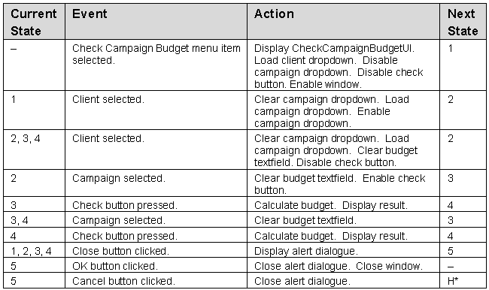
Event–Action Table

Slide 57
Revising the Sequence Diagrams and Class Diagrams
Producing the statechart diagram and the event–action table has identified some additional messages that will be sent to the user interface to control it
These will need to be added to the sequence diagrams and to the class diagram as operations of the UI class or of the lister interfaces

Slide 58
Revised First Sequence Diagram
Campaign
Manager
:CheckCampaign
Budget
CheckCampaignBudget( )
ccbUI := Check
Campaign
BudgetUI( this )
:CheckCampaign
BudgetUI
:ListClients
lc := ListClients( )
listAllClients( ccbUI )
*addClientName( name )
enable( )
disableCampaignList( )
disableCheckButton( )

Slide 59
Summary
In this lecture you have learned about:
What we mean by the presentation layer
How prototyping can be applied to user interface design
How to add boundary classes to the class model
How to model boundary classes in sequence diagrams
How design patterns can be applied to the user interface
How to model control using statecharts

Slide 60
References
Horrocks (1999)
Browne (1994)
Harel (1987)
Gamma et al. (1995)
(For full bibliographic details, see Bennett, McRobb and Farmer)

